Slide 1

Law, Land, Property Law and Land Law
Er. Subash Bhandari

Slide 2
Law ?????
Land ?????

Slide 3
Law
The system of rules which a particular country or community recognizes as regulating the actions of its members and which it may enforce by the imposition of penalties.(Definitions from Oxford Languages)
Laws are vital to a society because they provide guidelines for what is acceptable and what is not
Law is systematic operation means:
Command & sanction
Issued by sovereign (Superior body )
Rule of human conduct
A formal written enactment i.e. public, private, mandatory

Slide 4
Why Law
Establishing Order and Predictability
Safeguarding Rights and Liberties
Facilitating Social Change and Progress
Fostering Economic Growth
The Role of Laws in Global Harmony

Slide 5
Land
Land is the ultimate resource for life, without which life on earth cannot be sustained.
Land is considered as Wealth, Commodity, Scarce Resource and Community Resource
Land is principal source of livelihood for majority of the Nepalese People
Significant contribution in GDP(Gross domestic product)
highest engagement of active labor force with agriculture
The other sources of GDP (e.g. tourism) are mostly based on land and land resources

Slide 6
Land
Two unique characteristics of land distinguish it from other types of property.
land is immovable, so it cannot be physically transferred from one person to another.
land is permanent; it cannot be increased, decreased, or destroyed as can all other forms of wealth.

Slide 7
Land…
According to P.F. Dale- Land is a physical thing that includes the surface of the earth and all things attached to it both above and below. It is also an abstract thing that is manifest as a set of rights to its use with a value that can be treated enough through the physical object that cannot be moved. (Land Administration)
Legal definition – land means all category of land including those with buildings, gardens, trees, factories, lakes, ponds etc. (Land Survey Measurement Act 2019) {hUuf gfkhfFr P]g @)!( df pNn]v eP cg'zf/ – æhUufÆ eGgfn] 3/, jfu, au}rf, ¿v, sf/vfgf, tfn, kf]v/L, OToflb ePsf] ;d]t ;a} lsl;dsf] hUuf ;D´g' k5{ .}

Slide 8
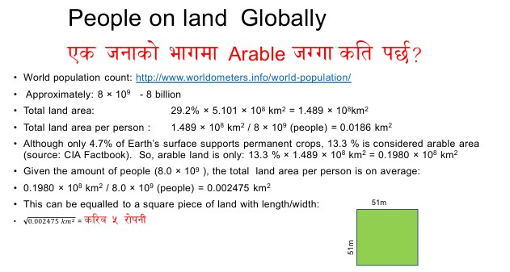

Slide 9
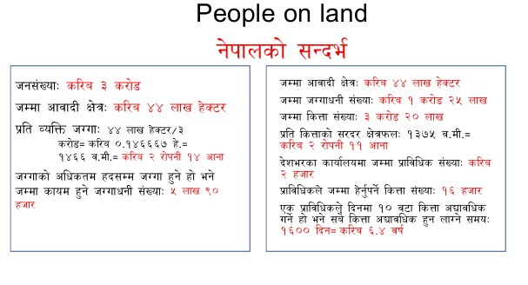

Slide 10
Property?????

Slide 11
Property
Property as an asset or collection of assets owned by an individual, group or entity. These assets can be tangible, such as land and building, or intangible, intellectual property rights.
The meaning of property also involve the legal rights associated with ownership, including the right to use, enjoy, or transfer the property.

Slide 12
Property Law
Property law in Nepal has undergone significant transformation with the enactment of the National Civil Code 2017, establishing a comprehensive legal framework that governs property rights, ownership, inheritance, and transactions. Real estate law in Nepal is primarily governed by the Lands Act 2021 (1964) and the National Civil Code 2017. These laws regulate ownership, transfer, partition, inheritance, and management of land and property in Nepal.

Slide 13
Property Law (Legal Framework and Sources)
National Civil Code 2017 (Muluki Civil Code 2074)
Comprehensive property rights framework
Inheritance and succession laws
Property transfer and transaction regulations
Gender equality in property ownership
Lands Act 2021 BS (1964 AD)
Land registration procedures
Measurement and valuation standards
Classification of land types
Government land policies
Constitutional Provisions
The Constitution of Nepal 2015 guarantees property rights under fundamental rights, ensuring:
Right to acquire, own, and dispose of property
Protection against arbitrary acquisition
Equal property rights regardless of gender
Compensation for government acquisition

Slide 14
Types of Property in Nepal
Classification by Nature
Movable Property
Cash, jewelry, vehicles
Livestock and agricultural produce
Household goods and personal belongings
Bank deposits and financial instruments
Immovable Property
Land and buildings
Permanent fixtures and structures
Trees and crops attached to land
Mining rights and easements

Slide 15
Classification by Ownership
Property Type | Description | Legal Characteristics
Private Property | Individually owned property | Full ownership rights, transferable
Joint Property | Co-owned by multiple parties | Shared ownership, partition rights
Community Property | Collectively owned by community | Community management, restricted transfer
Public Property | Government-owned property | Public use, government administration
Government Property | State-owned land and assets | Official use, strict transfer restrictions

Slide 16
Land Law
Discussion……?????

Slide 17
Land Law
Land Law focuses upon the uses and supply of land. It looks to facilitate how an owner of land may use it or moderate how others do so; this relationship can develop into ‘interests’ in the land.
Land law will examine the different interests that a person may have in land and how the law seeks to resolve conflicts through statute, common law and equity.
Land law impacts upon many facets of our day-to-day living, it determines: the difference between what is property and what is land; who owns property in the land; who may have access to land; your rights to land as a tenant, and; what you can do with your land.

Slide 18
Land Law…
Land law is unusual in that you can own it outright but still be limited in how you can use it. There are many reasons for this such as agreements reached by a previous owner or because you failed to notice how the land was used when you purchased it. As such, land law is heavily governed by how your neighbours interact with land and what you could have been expected to know.

Slide 19
LAND RELATED POLICIES AND LAWS IN NEPAL
Policies
The Constitution of Nepal, 2015
Article 51 has the mention of “policies of the state” under it “policies relating to agriculture and land reforms” are specifically written.
The major provisions comprise as follows:
(i) to implement scientific land reforms having regard to the interests of the peasants by ending the existing dual ownership in the lands;
(ii) to enhance product and productivity through land consolidation by disincentivizing the absentee landlordism(जमिन्दारवाद);

Slide 20
The Constitution of Nepal, 2015…….
(iii) to make land management and commercialization, industrialization, diversification, and modernization of agriculture by pursuing land use policies to augment agricultural product and productivity, while protecting and promoting the rights and interests of the peasants;
(iv) to make proper use of lands, while regulating and managing lands on the basis of, inter alia, productivity, nature of lands and ecological balance, and
(v) to provide for the farmers’ access to agricultural inputs, agro-products, at fair price and markets

Slide 21
Land Use Policy, 2015
Land use policy is a document formulated to guide the conservation of limited land and land resource of the nation for its conservation, optimum utilization, and effective management .
This policy has been premised on the ideology for achieving sustainable social, economic, and environmental development and prosperity through the optimum utilization of available land and land resource and this is indeed a long-term vision.
Characteristically, its significant policy provision comprises a “land use zoning” which has 10 categories of land use such as agricultural zone, residential zone, commercial zone, industrial zone, mine and mineral zone, forest zone, river, lake, and pond zone, public use zone, cultural and archaeological zone, other zones designated as per need.

Slide 22
Land Use Policy, 2015…….
This policy provisions emphasize:
(i) formulation of federal, provincial, and local level land use plans and their implementation;
(ii) preparation and implementation of physical infrastructural development projects in consonance with governance level-specific land use plan, and
(iii) ensuring the optimum use of agricultural land and its conservation by discouraging the use of agricultural land for the non-agricultural purpose, the culture of “keeping the agricultural land fallow”, and uncontrolled fragmentation of such agricultural land.

Slide 23
National Land Policy, 2019
National Land Policy, 2019 is an instrumental for the;
security of land rights and ownership
safe and systematic settlement for all citizens
peasants’ easy access to land
sustainable development of infrastructures
systematic land markets
ensuring food rights
environmental protection
mitigation of the adverse effects induced by climate change

Slide 24
National Land Policy, 2019……
gender equality
sustainable permanent solutions of all land-related issues.
This policy include:
(i) maintaining uniformity in the sectoral policies by formulating the main land policy;
(ii) addressing the issues of land tenure, ownership, rights, access and use in an integrated way;
(iii) addressing the land-related issues raised by different sections of society and sectors;

Slide 25
National Land Policy, 2019……
(iv) distributing the benefits equitably derived from land and land resource;
(v) implementing the constitutional arrangements and recommendations of High Level Land Reform Commissions (HLLRCs);
(vi) bringing land related international treaties, agreements, and commitments into the implementation of which Nepal has been a signatory;
(vii) contributing to country’s economic prosperity and bringing improvements in the living standard of Nepal through land’s productive use ;
(viii) making optimum use of governmental and public land by controlling its encroachment and excessive exploitation, and
(ix) maintaining good governance in land.

Slide 26
National Agro-forestry Policy, 2019
Agro-forestry is the integrated system of practice of agriculture, livestock-raising, and forest-related activities in one unit of land and each of these activities has an important contribution to the national economy of Nepal.
The vision of the policy is to “contribute to national prosperity through the development, extension, and commercialization of agro-forestry system”.
Its objectives comprise as follows:
(i) to augment the production of agriculture, livestock, and forest-related products by enhancing the productivity of land and using it multi-purposely;
(ii) to reduce population pressure on land and conserve environmental and biological biodiversity, maintain soil quality and develop climate friendly environmental system;

Slide 27
National Agro-forestry Policy, 2019…….
(iii) to ensure food security of local communities by creating opportunities for livelihood, employment and income generation through the intensive promotion of agro forestry;
(iv) to contribute to the economy through commercialization by creating investment opportunities in agro-forestry, and
(v) to promote the study, research and capacity in agro-forestry subject.
For accomplishing the vision and objectives of the policy, a host of policies and strategies have been devised as follows:
(i) prioritization and encouragement of commercial and collective farming of agro-forestry system;
(ii) simplification of agro-forestry research, value-chain and peasants’ access to markets;

Slide 28
National Agro-forestry Policy, 2019…….
(iii) management of enterprise and market based on agro-forestry products;
(iv) provisioning of financial incentives to agro-forestry sector;
(v) prioritization of agro-forestry system in fallow, abandoned and marginal lands;
(vi) development and promotion of location-specific agro-forestry models based on appropriateness;
(vii) prioritization of study, research, publicity and capacity-building of agro-forestry system, and
(viii) development of a system for the planning, coordination of budget and program, and monitoring and evaluation of agro-forestry at three levels of federal, provincial and local levels.

Slide 29
Acts
Birta Abolition Act, 1959
This Birta Abolition Act (1959) had been enacted for collecting land revenue from Birta (tax-free land). More specifically, the preamble of the Act states that it was desirable to abolish the feudal system that nurtured a system of land tenure to use land without paying land revenue to the state.
The Birta land was categorized into A and B. A category of Birta land included “the land under which the Birta-holder could collect the revenues as per the agreed contract system or lands used for collection of revenues as specified by the then revenue figure norms regardless of the obligation of payment of some portion of collected revenue or non-payment to the state and uninhabited public land and forest”. B category of Birta lands included all other Birta lands which are exclusive of category A.

Slide 30
Birta Abolition Act, 1959…….
Characteristically, some of the salient provisions of the Act comprise:
(i) abolition of all types of Birta lands on the very first day of the implementation of this Act;
(ii) conversion of all Birta lands into Raikar (state-owned land) by transferring its ownership to Nepal government;
(iii) automatic annulment of all entitlements and rights of Birta-holders pertaining to their land ownership;
(iv) annulment of all acts and other official documents or any other written letters which ensured the land ownership entitlements and rights to any person;

Slide 31
Birta Abolition Act, 1959…….
(v) registration of A category Birta land into the names of the sitting tenants
(vi) registration of all B categories of Birta lands into the names of Birta-holders provision of registering of B category of Birta lands in the name of tillers who can apply at land or land revenue offices with all necessary evidences within the time-frame specified by the government
(vii) arrangement of compensations to the A category Birta-holders by the Nepal government, and
(viii) special arrangement for the registration of Birta lands not registered in the name of any person by converting it into Raikar until June-July 1992 which could benefit sitting tenants.

Slide 32
Land (Survey and Measurement) Act, 1963
It was enacted and implemented for maintaining relations of people belonging to different classes and castes/ethnicities and conducting the cadastral survey for maintaining the facility of the citizenry and specifying the types or categories of land.
This Act has offered some important definitions which are useful for researchers, government officials, policy-makers, and advocacy activists. These comprise “land”, “cadastral survey”, “landlord”, “tenant”, “governmental land”, “public land”, and “community land”. The term “land” meant “all types of land including the land with houses, gardens, trees, factories, ponds, lakes, etc.” The term “cadastral survey” has been broadly defined.

Slide 33
Land (Survey and Measurement) Act, 1963…….
Some of the salient legal provisions of this Act comprise:
the authority/power of implementing cadastral survey is vested with the government of Nepal which can issue order for initiating it in the entire country or any specific area;
commencement of cadastral survey-related works in an area by issuing notification to landlords, tenants, peasants of the adjoining lands, traditional local land revenue collection functionaries, local government units at least 15 days prior to the onset of survey;
registration of the land through survey in the area land record book and the subsequent distribution of certificates of land ownership among owners

Slide 34
Land (Survey and Measurement) Act, 1963…….
(iv) mention of the evidentiary details of tenancy rights in the area land record book in the case of the tenanted land;
(v) legal arrangement for conducting survey of the lands not covered during the comprehensive cadastral survey time in a particular area
(vi) registration of land utilized/reclaimed/settled by anyone through encroachment as originally specified category of land;
(vii) specification of the legal obligation of the land owners to pay land revenue/s to the land revenue office/s as the area of landholding
(viii) land classification during the time of cadastral survey as per the specified criteria;

Slide 35
Land (Survey and Measurement) Act, 1963…….
(ix) constitution of a committee for investigating the non-compliance of this Act or regulation framed under it or correcting the registration of forest boundary, governmental land, public land, community land or trust land by encroaching or resolving any other general problem encountered during the land registration process through mapping;
(x) implementation of the cadastral survey by the government of Nepal;
(xi) implementation of cadastral survey by the government of Nepal for consolidation or integrated development of private, governmental, public or community land;
(xii) legal arrangement for the government of Nepal for issuing the license to any person or institution for conducting the cadastral survey by remaining within the provisions of this Act.

Slide 36
Act Concerning Ukhada, 1964
This Act Concerning Ukhada was enacted and implemented in 1964 which has been amended four times. This was specifically implemented in Nawalparasi, Rupendehi, and Kapilvastu.
The term “Ukhada” means “the land which is cultivated by the peasant on the stipulation of submitting the Naghat Pot (cash ground rent) to the landlord as per mutually agreed upon terms and conditions”. Indeed, this Act was based on the principle of “land to the tillers” (a basis of egalitarianism in the domain of land resource).

Slide 37
Land Management (Sale/Distribution) Act of Raptidun Development Sector, 1967
It was revealed that the land was not under the right of those people who were sold and distributed by the government but bizarrely, it was found to be controlled or grabbed by other people (not involved in the entire process). Hence, it was desirable to enact and implement this Act for provisioning the facility to the general people and maintaining their economic interests and equitable sale/distribution of the land of Raptidun.
The ideology behind this Act as indicated above the equitable distribution of land to the needy people in the area where there was the cornucopia of forested land awaiting reclamation for human settlement and agricultural purposes.

Slide 38
The Lands Act, 1964
The preamble of the Act explicitly shows three interrelated objectives as follows:
(i) to shift the inactive capital from land and burden of the population to invest in other sectors of the economy to accelerate the pace of economic development of the country;
(ii) to bring improvements in the life-standard of actual peasants dependent on land through equitable distribution of agricultural land and making agriculture-related knowledge and means available, and
(iii) to maintain the facility to general people and economic welfare by encouraging optimum augmentation in agricultural production.

Slide 39
The Lands Act, 1964….
The Act seems to have specified two main agenda as follows:
(i) creation of relatively egalitarian agrarian structure through the imposition of land ceilings and appropriation of land in excess of ceilings for the redistribution, and
(ii) ensuring the land rights to the tenants through the legal provision of “tenancy rights”.
The Act provided the relative security of tenancy rights for the first time in the agrarian history of Nepal.
The Act also had the provision of regulating the agricultural rents to incentivize the tenants for enhancing production.

Slide 40
The Lands Act, 1964
Scores of other legal provisions seem very relevant and positive to the relatively marginalized peasants/settlers. These comprise the following:
(i) making the land available to the landless Dalits once as specified within three years and such land right cannot be transferred to anyone until 10 years;
(ii) making lands available to landless squatters and
(iii) managing unsystematic settlers.

Slide 41
Jhora Area Land Act, 1971
Its preamble states that it was desirable to manage the reclaimed forest land of the Jhora area in Morang, Sunsari, and Jhapa districts for the maintenance of peace and order and economic welfare of the general public as per changing time.
The Act has defined Jhora as, “area under settlement and cultivation through the reclamation of forests as legally mandated”.
It defined landowner as “a person with legally registered land in his/her name or a person with such right for registration (of land)”. The term “Raiti” has been defined as “ a person who has reclaimed land in the Jhora area or a person settling in the same place by cultivating land through the use of the family labor”.
The Act has been inherently geared toward the shift of the growing hill population in the Tarai area for bringing the forest area under reclamation and settlement to augment agricultural production and increase the state’s land revenue.

Slide 42
National Parks and Wildlife Conservation Act, 1972
National Parks and Wildlife Conservation Act (1972) has been enacted and implemented due to the desirability for maintaining general people’s ethics and facilities through the management of national parks, conservation of wildlife and its habitat, control in hunting and conservation, promotion, development, and proper management as well as utilization of places with special importance from the perspective of natural beauty.

Slide 43
Pastureland Nationalization Act,1974
The preamble of the Act states that it was desirable to nationalize the pastureland for the facility and the economic well-being of the general people. It has defined ‘pastureland’ as “a land used exclusively for grazing of domesticated animals regardless of its official registration or non-registration as a pastureland”.
Some of the salient provisions of the Act comprise the following:
(i) transfer of the ownership of pastureland in the name of the government on the very day of the onset of nationalization triggering the automatic nullification of the ownership of “Darthawala”;
(ii) exemption for retaining the ownership of the pastureland used privately by the “Darthawala” for grazing provided it is under the land ceiling specified by the prevailing law of the land;
(iii) exemption for the continuation of the ownership of pastureland used for horticulture, stock-raising, herb cultivation, and tea cultivation;

Slide 44
Pastureland Nationalization Act,1974……
(iv) institutional arrangement for the right amount of compensation to be paid by the Nepal government as per the recommendation made by the legally constituted committee
(v) legal arrangement made for maintaining a “separate pastureland record book” at land revenue office and handing over it to the local rural municipality for its protection and animal grazing
(vi) legal arrangement provided to rural municipality for permitting the grazing of the domesticated animals by imposing “grazing fees” and Rs.1 at the most per smaller animal
(vii) institutional arrangement for the deposit of such “grazing fees” in the fund of rural municipality, etc.

Slide 45
Guthi Corporation Act, 1976
According to the Act,”Guthi” means and includes a Guthi (trust) endowed by any philanthropist through relinquishment of his or her title to movable or immovable property or any other income yielding property or fund for the operation of any shrine (matha ) or festival, worship or feast of any God, Goddess or for the construction, operation or maintenance of any temple, the shrine (devasthal ), rest house (dharmashala), shelter (pati), inn (pauwa), well, tank, road, bridge, pasture, garden, forest, library, school, reading hall, dispensary, treatment facility, house, building or institution for any religious or philanthropic purpose.
There are three categories of trusts, namely, Rajguthi (state trusts managed and operated by Guthi corporation -government), Chut Guthi (state trusts under private management which are also on inheritable basis) and “personal Guthi” is an individual private trust.

Slide 46
Guthi Corporation Act, 1976….
Some of the relevant provisions of the Act comprise
(i) abolition of Jimidari system in the trust land;
(ii) management of the tenancy right for the tiller of the trust land;
(iii) specification for the Kut Tero (fixed agricultural rent or ground rent) in the trust land tilled under tenancy provision similar to the one in the Raikar land as per the location and type of land;
(iv) institutional denial of tenancy rights on the stipulation of the failure to pay ground rent on the specified time;
(v) special arrangement for the alienation of the tenancy right

Slide 47
Land Acquisition Act, 1977
It is in the process of being amended very soon to address many contemporaneous issues in land acquisition.
Some salient provisions of the Act comprise as follows:
Power vested with Nepal government for the acquisition of land for public work
Compensation to be paid to the affected party for the loss incurred upon
Possibility of providing land in lieu of land acquired by Nepal government
Compensation for the land appropriated in excess of ceiling set by government does not exceed the figure as specified in the Lands Act, 1964;
Compensation to be received by tenant

Slide 48
Land Revenue Act, 1978
Land Revenue Act has two major objectives as follows:
Collection of land revenues, and
Reclamation of land.
Some salient relevant provisions of the Act comprise as follows:
maintenance of the official record of landowners in all places (including in areas where cadastral survey has not been conducted through the use of existing land records);
making official effort for conducting cadastral survey of lands left under the Land (Cadastral Survey and Measurement) Act (2062) and registering such lands;
rendering services for land registration, transfer of land ownership (in other names/s), and adjusting land records;
sharing information by land revenue office on the change/s in landownership official record under tenancy or excess land above ceiling (set by government) with land reform office;

Slide 49
Land Revenue Act, 1978…..
(v) remission of land tax by the Nepal government to the peasants (landowners) in the events of the damage of land caused by river or landslide and failure or depredation of main crop triggered by drought or other natural calamities upon the field investigation made by land revenue office and its subsequent recommendation for remission;
(vi) prohibition on the private registration of governmental, public or community lands
(vii) prohibition on reclamation of unregistered governmental land for human settlement
(viii) incarceration of a culpable person and his/ her accomplice for three years or imposition of NRs. 3,000 as fine or provision of both punishments in the event of registration of governmental land or public land in his/her name or reclamation of such lands, etc.

Slide 50
Nepal Trust Act, 2008
After the declaration of Nepal as a republic state in 2006, there was a hue and cry from the public about the property (movable and immovable) of late king Birendra, his late queen, and their late family members. As a result, an Act was framed in 2008 and implemented for bringing all their property under the trust for its use in national interest through its proper management.
Important provisions of the Act comprise:
(i) Use of the trust property in the national interest that can accrue comprehensive and optimal public benefits
(ii) Role of the trust management committee which is legally responsible for the promotion and protection of trust property and income generation by implementing activities as specified in the Act;
(iii) Prohibition on the sale of the trust property and provisioning it to anyone on the usufructuary rights;
(iv) Sale of trust property by trust management committee for specific purpose for promoting the national interests as approved by the cabinet, etc.

Slide 51
Forest Act, 2019
“Forest” as “an area with fully or partially covered with trees or bushes”
“Forest area” as “an area with forest boundary or an area covered by forest without boundary or grassland, pastureland, snow-capped mountain or mountain bereft of snow, road, lake, pond, wetland, river, stream, the sand area along the course of the river, unregistered public land located within the forest excluding the area under private ownership or an area managed by any other prevailing law”.
The Act has categorized the forest of Nepal into seven as follows:
(i) government-managed forest;
(ii) community-managed forest;
(iii) jointly-managed forest (by users and government);
(iv) leasehold forest;
(v) religious forest;
(vi) public and private forests, and
(vii) urban forest.

Slide 52
Forest Act, 2019….
Relevant provisions
The ownership of national forest vested with Nepal government
Acquisition of public or private land including the physical structures by the Nepal government in case of its need for forest protection in the process of boundary demarcation of national forest prohibition on the registration of national forest land in people’s names
Power vested with the Nepal government for the formulation of land use plan for sustainable forest protection, management and maintaining equilibrium between environment and development in any designated area of national forest and
Prohibition on the settlement or resettlement within the forest area.

Slide 53
Land Use Act, 2019
Act states that it has been enacted for the optimum and sustainable benefit through the classification of land, integrated use, and effective management
The important provisions of the Act has been the “classification of land use areas” into 10 different types as follows:
(i) Agricultural area;
(ii) Residential area;
(iii) Commercial area;
(iv) Industrial area;
(v) Area of mines and minerals;
(vi) Forest area;
(vii) Area of river, stream, lake, wetland;
(viii) Area of public use;
(ix) Area of cultural and archaeological importance, and
(x) Any other area designated by Nepal Government as per necessity.

Slide 54
Land Use Act, 2019…
Provisions of the Act comprise the following;
Preparation of land-use area map by the federal ministry for every local unit and handing it over within a year after the onset of this Act which can be updated periodically by “Local Land Use Council” through the consideration of its necessity, and
Formulation of land use plan by Nepal government, the provincial government and local unit after the preparation of long-term land-use plan approach paper through the detailed study of the land situation, population growth rate, the necessity of food and housing, and demand of land for economic development and infrastructural construction

Slide 55
Land Use Act, 2019…
More importantly, a land use plan must be prepared with the clear visibility of the following areas:
industrial corridor;
special economic zone;
national project;
inter-provincial project;
natural and physical properties of national importance worth preserving;
religiously and culturally important sites with international identity and human belief;
school or other educational site, and area of road, health institution, and irrigation canal;
sensitive site from the perspective of national security;
disaster-prone area;
protected area for environmental cleanliness and conservation of biological diversity, and
other necessary areas.

Slide 56
Land Use Act, 2019…
There is also a specific provision for updating the land owners’ records and certificates of land ownership by the local unit within its territory in accordance with the land use classification map.
One of the important legal provisions of the Act is on “control of land fragmentation and land consolidation”. It articulates to set the necessary criteria and necessary standards to control land fragmentation and regulate land plotting.
The Act specifically states, “Nepal government will establish land bank at the local unit as per necessity for the implementation of the system concerning the land use classification and enhancing productivity through the optimum utilization of land”

Slide 57
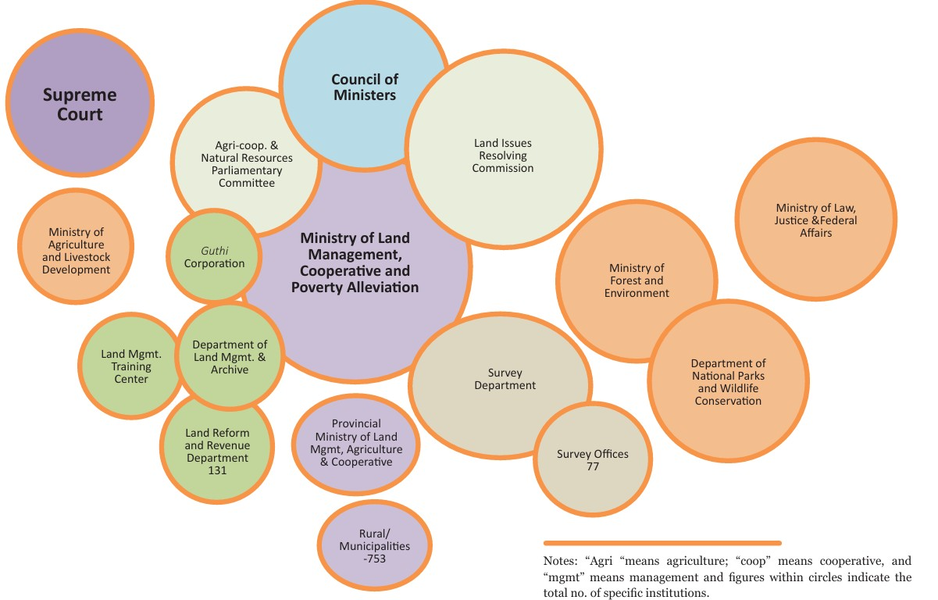
Land Related Government Institutions

Slide 58
Importance of land law on development of country
Land laws provide a legal framework that is essential for establishing and protecting property rights, promoting economic development, ensuring social justice, and managing conflicts related to land use. They contribute to the overall stability, prosperity, and sustainability of a society.
Importance
Property Rights and Ownership:
Legal Certainty: Land laws provide a legal framework that defines and protects property rights. Clear and enforceable property rights are essential for individuals and businesses to feel secure in their ownership, encouraging investment and economic development.
Transfer of Ownership: Land laws establish the legal procedures for the transfer of property ownership. This ensures that transactions are transparent, recorded, and legally binding.
Land Use Planning and Zoning:
Orderly Development: Land laws often include provisions for land use planning and zoning regulations. These help in organizing urban and rural spaces, preventing haphazard development, and promoting orderly growth.
Environmental Protection: Zoning laws may include provisions for environmental protection, ensuring that certain areas are preserved for conservation or restricted to specific types of development to prevent environmental degradation.

Slide 59
Importance of land law on development of country….
Economic Development:
Collateral for Financing: Land often serves as a valuable asset that can be used as collateral for loans and other financial transactions. A well-established land law system facilitates secure transactions and encourages financial institutions to lend money for development projects.
Investment Incentives: Clearly defined land rights attract investments by providing potential investors with confidence in the security of their property.
Social Justice:
Land Redistribution: In many societies, land laws address issues of social justice by regulating the distribution of land to ensure fair and equitable access. This may involve mechanisms for land reform, redistributing land to address historical injustices or promote economic equality.
Conflict Resolution:
Dispute Resolution: Land laws provide mechanisms for resolving disputes related to property, boundaries, and land use. A well-functioning legal system helps in preventing and resolving conflicts, reducing the likelihood of disputes escalating into larger issues.
Infrastructure Development:
Public Projects: Land laws enable governments to acquire land for public projects such as roads, schools, and utilities through mechanisms like eminent domain. This ensures that infrastructure projects can be carried out for the public good.
Cultural and Heritage Preservation:
Cultural Significance: Land laws may include provisions for the protection of culturally significant sites or heritage areas. This helps preserve historical landmarks and maintain a connection to cultural identity.

